Slide 1
FA18-ILS-Z534-12423 Search Final Project
Yelp review star rating prediction using review texts
Under supervision of Prof. Xiaozhong Liu
Prajakta Patil – patilpr@iu.edu
Sahithya Sridhar – sahsrid@iu.edu
INDIANA UNIVERSITY BLOOMINGTON

Slide 2
Contents
Introduction
Literature Review
Data Collection and Processing
Design of Experiment
Results and Evaluation
Conclusions
References

Slide 3



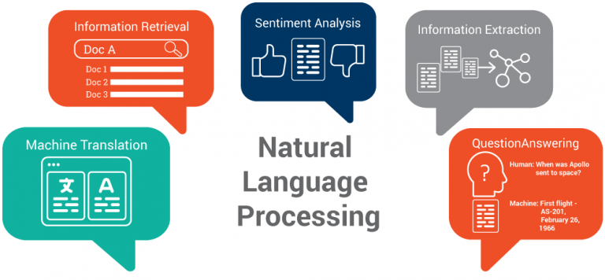
Toolset

Slide 4
Introduction
Yelp reviews are in text and star rating format
Ability to predict star rating from text review will help users in choosing business for visit
If users can trust Yelp reviews, it can increase Yelp user count

Slide 5
Literature Review
Peter D. Turney predicted semantic orientation (SO) of reviews provided on ‘Epinions’ website. He used Pointwise Mutual Orientation applied to Information Retrieval (PMI-IR) algorithms by applying it to 2-word phrases extracted from review texts. He achieved overall accuracy of 74% in tagging reviews into recommended and non-recommended category.
Fan and Khademi tried predicting star rating of review from review text only. They extracted most frequent words from raw text, most frequent words after applying part of speech tags (POS) and most frequent adjectives from POS tagged words list. They trained 4 machine learning algorithms namely Linear Regression, Support Vector Regression (normalized and non-normalized) and Decision Tree Regression on these feature sets. They used Root Mean Square Error (RMSE) for evaluation of these methods. They achieved best results with Linear regression algorithms in predicting star rating from review text.

Slide 6
Data Collection and Processing
Yelp Dataset: https://www.yelp.com/dataset/challenge
‘Round 12’ Yelp data set from Yelp website. Data for 11 metropolitan areas, 174k businesses and included 5.2 million reviews.
Converted both original ‘reviews.jason’ and ‘business.json’ files into CSV format.
We removed unnecessary symbols such as ‘&, /’, transformed words in lowercase, removed stop-words.
Converted reviews to vector form using bag-of-words approach.

Slide 7
Design of Experiments
Feature generation: We extracted various features from data as shown below
Structural features: Number of sentences per review
Lexical features: TFIDF of most frequent unigrams
Metadata features: Star rating of each text review
Converting data in matrix form:
We used count vectorizer to convert processed data (bag-of-words) in sparse matrix format with rows for words and their frequency
Machine learning:
Trained Multinomial Naïve Bayes, Random Forest and Logistic Regression algorithms on 30% data. Models were then applied on remaining 70% test data to check for accuracy in predicting star rating from review text.
Notes:
Structural features allow understanding if review length and star rating are related
Lexical features help us find most relevant features i.e. words for reviews
Matadata features allow connecting review text and star rating
Machine learning algorithms trained on data then allows finding how various algorithms perform in predicting star rating of review from review text alone

Slide 8
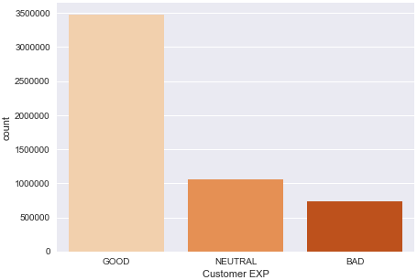
Results and Evaluation
Most reviews were received for review class ‘Good’ i.e. ones with star rating 4 and 5
Notes:
Good – 4 and 5 Star
Neutral – 2 and 3 Star
Bad – 1 Star

Slide 9
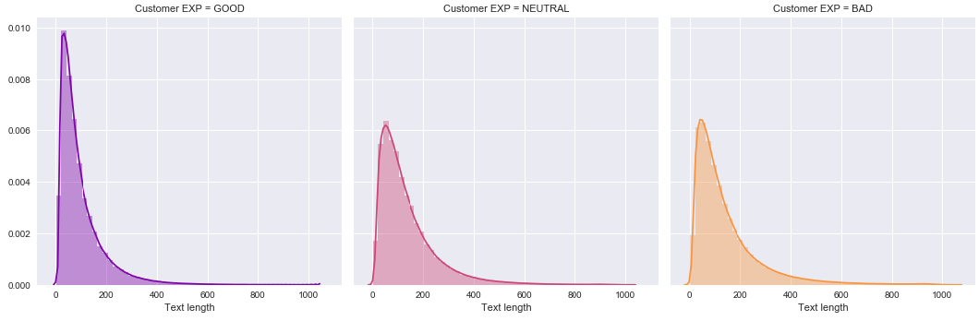
Results and Evaluation…contd
Most users provided short reviews irrespective of review class
Notes:
Users provided reviews mostly when their experience at a business was good and when they rated it 4 or 5 star out of possible 5 stars
Reviews were mostly short in length irrespective of user experience

Slide 10
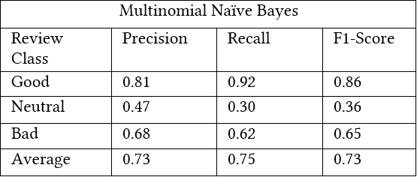
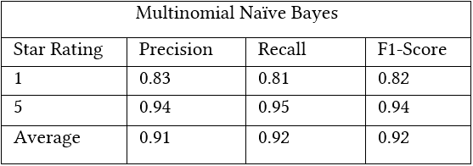
Results and Evaluation…contd
Multinomial Naïve Bayes on all 5 ratings
Multinomial Naïve Bayes on 1- and 5-star rating only
Notes:
Good – 4 and 5 Star
Neutral – 2 and 3 Star
Bad – 1 Star
Evaluation – Compared Precision and recall values for all 3 machine learning algorithms. This allows to check how well the algorithm could find relevant reviews and how well it could classify it as star rating
Precision and recall improves significantly when trying to predict star rating 1 and 5 for all algorithms

Slide 11
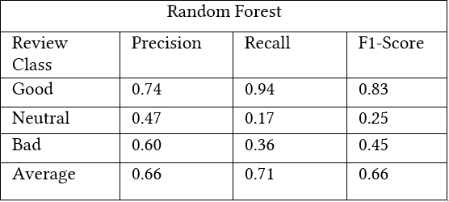
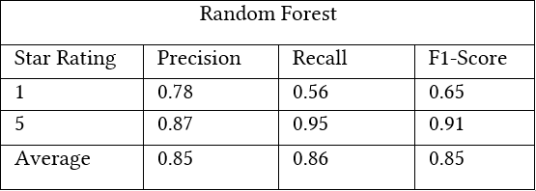
Results and Evaluation…contd.
Random Forest on all 5 ratings
Random Forest on 1- and 5-star rating only
Notes:
Good – 4 and 5 Star
Neutral – 2 and 3 Star
Bad – 1 Star
Evaluation – Compared Precision and recall values for all 3 machine learning algorithms. This allows to check how well the algorithm could find relevant reviews and how well it could classify it as star rating
Precision and recall improves significantly when trying to predict star rating 1 and 5 for all algorithms

Slide 12
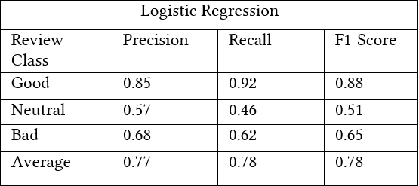
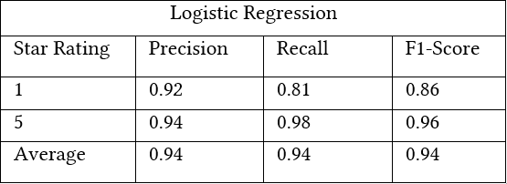
Results and Evaluation…contd.
Logistic Regression on all 5 ratings
Logistic Regression on 1- and 5-star rating only
Notes:
Good – 4 and 5 Star
Neutral – 2 and 3 Star
Bad – 1 Star
Evaluation – Compared Precision and recall values for all 3 machine learning algorithms. This allows to check how well the algorithm could find relevant reviews and how well it could classify it as star rating
Precision and recall improves significantly when trying to predict star rating 1 and 5 for all algorithms

Slide 13
Conclusion
Star rating 1 and 5 can be predicted with higher accuracy that star rating 2 and 3.
Logistic Regression performed best among all 3 algorithms with precision and recall of 77% and 78% respectively when applied to all 5 ratings.
Logistic Regression achieved precision and recall of 94% when applied to star rating 1 and 5 only.
Notes:
Predicting star rating 1 and 5 is probably easier as there might be same set of words occurring most often for these such as ‘awesome’ or ‘good’ for star rating 5 and ‘bad’ or ‘horrible’ for star rating 1.
Star rating 2 and 3 are probably difficult to predict from review text alone as there might be no specific words that would typically be used for these reviews only.

Slide 14
References
1. Peter D. Turney, Thumbs Up or Thumbs Down? Semantic Orientation Applied to Unsupervised Classification of Reviews: http://aclweb.org/anthology/P02-1053
2. Mingming Fan and Maryam Khademi, Predicting a Business’ Star in Yelp from Its Reviews’ Text Alone: https://arxiv.org/ftp/arxiv/papers/1401/1401.0864.pdf
3. Yelp Wikipedia: https://en.wikipedia.org/wiki/Yelp
4. Random forest Wikipedia: https://en.wikipedia.org/wiki/Random_forest
5. Logistic Regression: https://www.medcalc.org/manual/logistic_regression.php
6. Precision and Recall Wikipedia: https://en.wikipedia.org/wiki/Precision_and_recall

Slide 15
Thank you !

